Slide 1
ABC Call Volume Trend Analysis
Description:
Customer Experience (CX) Inbound calling team for 23 days. Data includes Agent_Name, Agent_ID, Queue_Time [duration for which customer have to wait before they get connected to an agent], Time [time at which call was made by customer in a day], Time_Bucket [for easiness we have also provided you with the time bucket], Duration [duration for which a customer and executives are on call, Call_Seconds [for simplicity we have also converted those time into seconds], call status (Abandon, answered, transferred). A customer experience (CX) team consists of professionals who analyze customer feedback and data, and share insights with the rest of the organization. Typically, these teams fulfil various roles and responsibilities such as: Customer experience programs (CX programs), Digital customer experience, Design and processes, Internal communications, Voice of the customer (VoC), User experiences, Customer experience management, Journey mapping, Nurturing customer interactions, Customer success, Customer support, Handling customer data, Learning about the customer journey.

Slide 2
ABC Call Volume Trend Analysis
Business Understanding:
Advertising is a way of marketing your business in order to increase sales or make your audience aware of your products or services. Until a customer deals with you directly and actually buys your products or services, your advertising may help to form their first impressions of your business. Target audience for businesses could be local, regional, national or international or a mixture. So they use different ways for advertisement. Some of the types of advertisement are: Internet/online directories, Trade and technical press, Radio, Cinema, Outdoor advertising, National papers, magazines and TV. Advertising business is very competitive as a lot of players bid a lot of money in a single segment of business to target the same audience. Here comes the analytical skills of the company to target those audiences from those types of media platforms where they convert them to their customers at a low cost.

Slide 3
Approach
THE given data is cleaned there is not required clean the data for analysis
117989 rows are their I done some of the analysis with the help of pivot table
And some formulas it is very important understand the learn the concept excel in the analytics
Tech stack used
power point ,excel

Slide 4
Insight
I got more information about usage of excel as well the real power of excel in the
Analytics and got the information about call trends means customer support
Concept of Timeslot, Call_Status, IVR_Duration, etc understand clearly
REQUIREMENTS
Calculate the average call time duration for all incoming calls received by agents (in each Time_Bucket).
Show the total volume/ number of calls coming in via charts/ graphs [Number of calls v/s Time]. You can select time in a bucket form (i.e. 1-2, 2-3, …..)
As you can see current abandon rate is approximately 30%. Propose a manpower plan required during each time bucket [between 9am to 9pm] to reduce the abandon rate to 10%. (i.e. You have to calculate minimum number of agents required in each time bucket so that at least 90 calls should be answered out of 100.)
Let’s say customers also call this ABC insurance company in night but didn’t get answer as there are no agents to answer, this creates a bad customer experience for this Insurance company. Suppose every 100 calls that customer made during 9 Am to 9 Pm, customer also made 30 calls in night between interval [9 Pm to 9 Am] and distribution of those 30 calls are as follows:

Slide 5
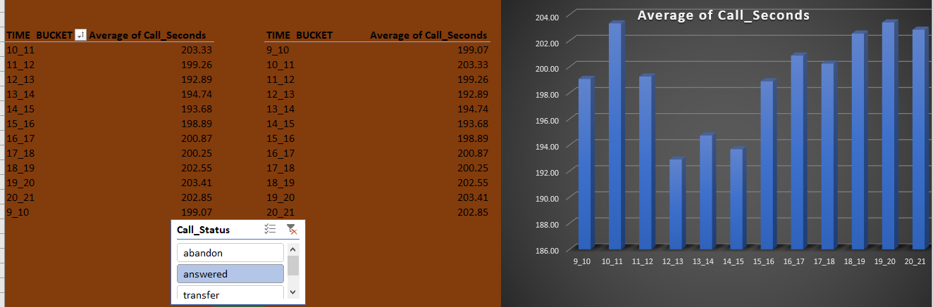
average call time duration
ddd
Maximum number of call in 10-11 time bucket
Average call time for all answered call is 198.6

Slide 6
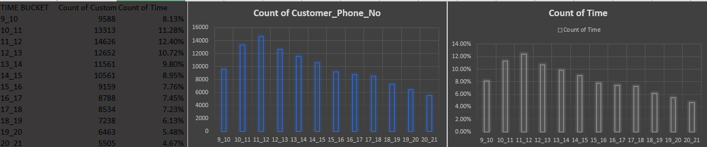
total volume/ number of calls coming in via charts/ graphs
Hhgghghhh
Maximum count of call in 11_12 bucket
And least in 20_21
We can observe that there is drastically down after 11_12 time bucket

Slide 7
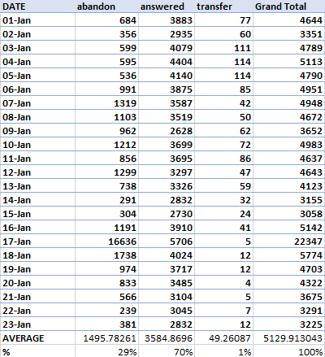
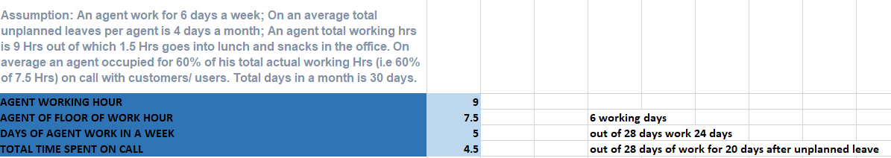
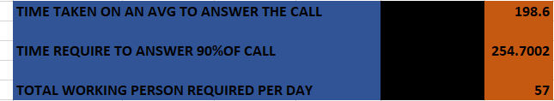
As you can see current abandon rate is approximately 30%. Propose a manpower plan required during each time bucket [between 9am to 9pm] to reduce the abandon rate to 10%. (i.e. You have to calculate minimum number of agents required in each time bucket so that at least 90 calls should be answered out of 100.)

Slide 8
Average duration spent in a call is 198.6 sec
Time required to answer 70% of the calls
198.6 * 5130 * 0.7 / 3600 = 198.10 hours.
A person works 4.5 hours a day,
Total number of people need to work in a day to get a 70%
198.10/4.5
= 44 People.
Time required to answer 90% of the calls
= 198.6 * 5130 * 0.9 / 3600
= 254.700 hours.
Total number of people need to work in a day to get 90% answering rate =254.700/4.5
= 57 People

Slide 9
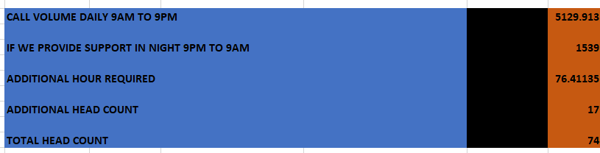
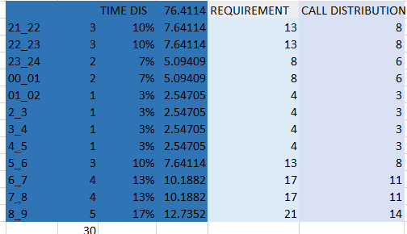
Let’s say customers also call this ABC insurance company in night but didn’t get answer as there are no agents to answer, this creates a bad customer experience for this Insurance company. Suppose every 100 calls that customer made during 9 Am to 9 Pm, customer also made 30 calls in night between interval [9 Pm to 9 Am] and distribution of those 30 calls are as follows:

Slide 10
A person works effectively 4.5 hours a day
Average duration spent in a call 198.6 sec
Call volume daily 5129.913
Provide support in night 1539
Additional hour requires 76
Additional headcount 17
Total head count 17+57=74
Need 17 more man-power to support at night each day and also keeping the abandon rate to 10%.

